Slide 1

Super computers
Presented by Aoun haider

Slide 2
History:
The term supercomputing arose in the late 1920’s in the United States at Columbia University.
These computers alone work used to do 64 computers.
The working speed of these computers were 300 million calculation operations per second.
As long as it takes us to count to 8, this supercomputer could solve 300 million questions of arithmetic and logic questions.
The supercomputers were faster than we thought.

Slide 3

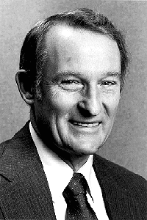
Inventor:
The CDC(control data crop) 6600 is generally recognized as the first supercomputer built in 1964, it was designed by “Seymour Cray”, and ran at about 1 megaflop(a million floating point operations per second).

Slide 4

Inventors:
“Boris Babayan” is a Russian scientist who is also known as a creator of supercomputers. He also receive a Lenin prize in 1987.

Slide 5

Why And What Was The Need For Super Computers ?
For testing complex mathematical models.
Physical phenomena and design.
Climate and weather changes.
Fast processing speeds.
Extra and super sized storage capacities.

Slide 6
Introduction:
A supercomputer is a computer with great speed and memory. They are usually thousands of time more faster than ordinary personal computers. Supercomputer with distributed memory consist of many(100-10000)nodes. These computers have high level computing performance and its performance is measured in FLOPS(floating point operations per second).

Slide 7
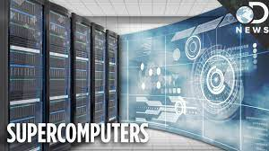
Introduction:

Slide 8
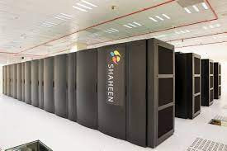
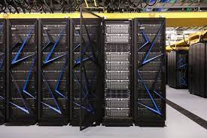
Types:
There are many types of supercomputers. Few of them are discus below.
1. Jaguar 7. Jugene
2. Titan 8. Kraken
3. Nebulae 9. Plelades
4. IBM Roadrunner 10. IBM Sequoia
5. K Computer
6. Tianhe-1

Slide 9
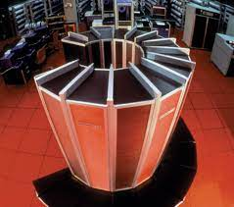
Characteristics:
They can support more than a hundred users at a time.
This machine is also faster than the imagination of humans.
These computers are capable of doing all kinds of work.
Many people can work at the same time on a supercomputer.
These are the most expensive computers and can be made anytime.
Supercomputers have huge storage capacity.

Slide 10
Features:
They have more than 1 CPU (Central Processing Unit) which has instructions so that it can interpret instructions and perform arithmetic and logical tasks.
The supercomputer can support extremely high computation speeds of CPU's.
Supercomputers having more than one CPU are very fast and very easily able to perform arithmetic and logic tasks.
They were initially used in national security, nuclear weapon design and cryptography and are still used today. But nowadays they are also employed in aerospace, automotive and petroleum industries.

Slide 11
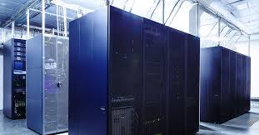
Uses:
Film Making
Military and Defense
Weather Department
Scientific Research Department
Store Database
Smog Control System
Play Game
Data Encrypt or Mining

Slide 12
Uses:
1.) Film Making
Today, supercomputers are also being used in the film industry.
It is used to create imaginary scenes in the film.
Supercomputers are also used to make FVX and animation in Hollywood and Bollywood.
2.) Military and Defense
Today supercomputer is used to conduct virtual tests of nuclear explosions and weapon ballistics.

Slide 13
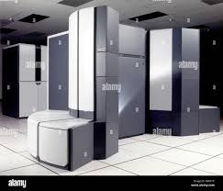
Uses:
3.) Weather Department
Today, supercomputers are used in almost every weather department in the world.
Weather is predicted with the help of a supercomputer.
Let us know how the weather will be today, on what day and how much rain is going to happen.
All information about the weather is available through the help of a supercomputer.
4.) Scientific Research Department
In large space organizations such as ISRO and NASA, supercomputers are used.

Slide 14
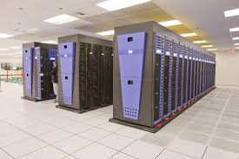
Uses:
5.) Store Database
Some large-scale companies require supercomputers to extract useful information from data storage houses or cloud systems and to hold massive amounts of data.
Such as Google, Bing, web hosting provider these all companies used supercomputers.
6.) Smog Control System
Supercomputers are also used in these departments.
Today, air pollution has arisen in almost all major cities of the world.

Slide 15
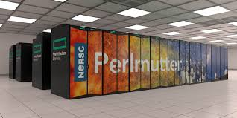
Uses:
These departments check fog and pollution with the help of supercomputers, what today’s air pollution is and how to reduce it.
7.) Play Game
In today’s world, super computers are being used to play visual and graphics games.
8.) Data Encrypt or Mining
These super computers are also used for encrypting the data or mining the data.

Slide 16
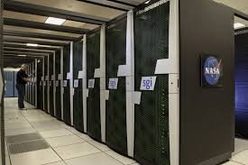
Advantages:
Supercomputers have more than one CPU and ten thousand processors.
A supercomputer can decode any password because the speed of the supercomputer is very fast, so it finds the password immediately.
Today big companies are using supercomputers because other computers take ten to fifteen days to do any work, same supercomputer takes one to two days to do their work, which saves both time and money.
Supercomputers can run many types of operating systems.

Slide 17
Disadvantages:
A supercomputer needs a lot of electricity to run.
To install a supercomputer, a lot of land is required.
Approximately 500 or 550 square land required to install a supercomputer it occurs.
A supercomputer has a lot of processors due to which the supercomputer heats up very quickly.
Supercomputers are so expensive that no ordinary person can afford it.

Slide 18
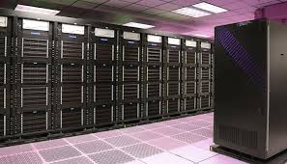
Rates:
Supercomputers are very expensive. Some of world top supercomputer rates are:
The Jaguar supercomputer price 104 million US Dollar.
Titan supercomputer price is 90 million US dollars.
The Roadrunner supercomputer price is 100 million US Dollar.
Fugaku supercomputer price is 1 billion US dollars (total programe cost).

